Slide 1
Cloud Computing
Introduction

Slide 2
Lecture Contents
What is Cloud Computing?
History of Cloud Computing
Early models of Cloud Computing
Importance of Cloud Computing
Applications of Cloud Computing
Characteristics of Cloud Computing
Advantages of Cloud Computing
Delivery models and services
Cloud activities
Ethical issues in Cloud Computing
Cloud vulnerabilities.
Parallel Computing.
Challenges
Distributed Systems
Assignment

Slide 3
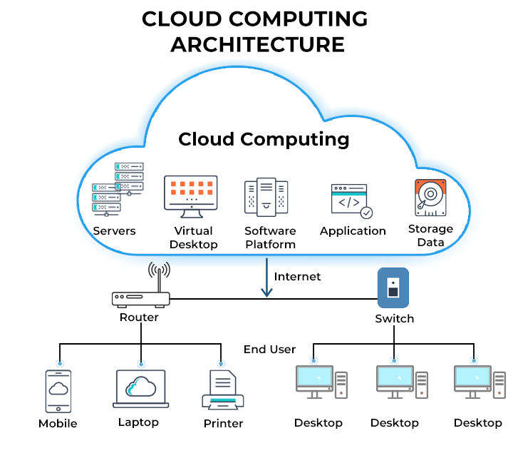
What is Cloud Computing?
Cloud computing means using computers, storage, software, and other services through the Internet instead of keeping everything on your own computer.
Example:
When you use Google Drive, your files are stored on Google's computers (servers), not only on your laptop. You can access them anytime and from anywhere through the Internet.
Examples of cloud services:
Google Drive → store files online
Gmail → use email online
Netflix → watch videos online
OneDrive → store and access files
Microsoft Azure / AWS → use servers and computing power online
Cloud Computing = Using computing services over the Internet.

Slide 4
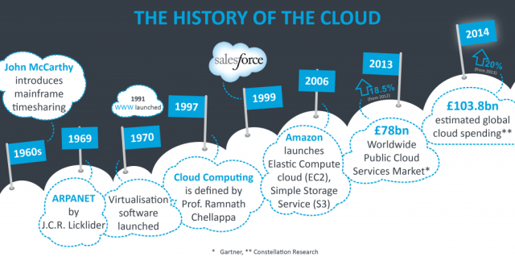
History of Cloud Computing
1960s: Time-sharing – many users shared one large computer.
1970s: Virtualization – one computer could run multiple virtual machines.
1990s: Internet growth – services started moving online.
1999: Salesforce introduced cloud-based software (SaaS).
2006: Amazon launched AWS, a major milestone in modern cloud computing.
Today: Cloud is widely used for storage, software, AI, databases, and computing.

Slide 5
Early Models of Cloud Computing
Basic reasoning: information and data processing can be done more efficiently on large farms of computing and storage systems accessible via the Internet.
Two early models:
Grid computing – initiated by the National Labs in the early 1990s; targeted primarily at scientific computing.
  “Grid computing is the collection of computer resources from multiple locations to reach a common goal. The grid can be thought of as a distributed system with non-interactive workloads that involve a large number of files.” from Wikipedia
Utility computing – initiated in 2005-2006 by IT companies and targeted at enterprise computing.
  “Utility computing is a service provisioning model in which a service provider makes computing resources and infrastructure management available to the customer as needed, and charges them for specific usage rather than a flat rate.” from Wikipedia
Notes:
Maybe show some examples online

Slide 6
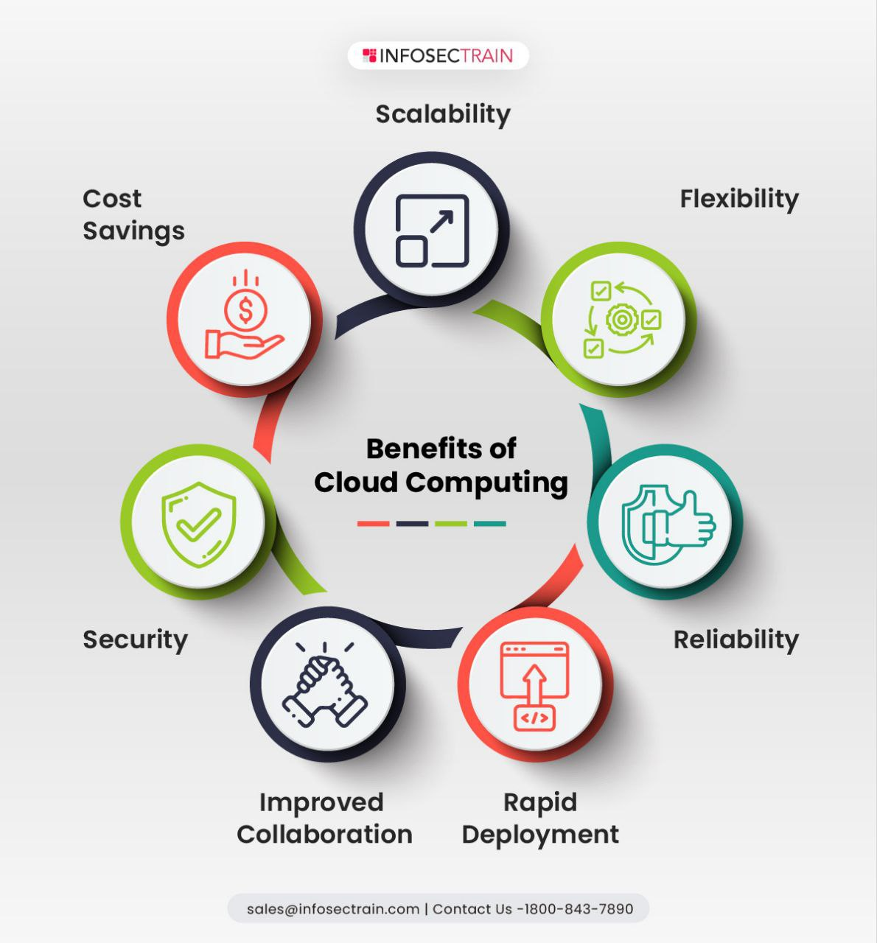
Importance of Cloud Computing
Cloud computing is important because it provides flexible, scalable, cost-effective, and easily accessible computing resources over the Internet.
Cost Saving: Reduces hardware and IT costs.
Anywhere Access: Access data and applications from anywhere.
Scalability: Easily increase or decrease resources.
Data Security & Backup: Helps protect and recover data.
Fast & Flexible: Quickly provides computing resources.
Collaboration: Multiple users can work on the same data.
Automatic Updates – Software and systems can be updated easily.

Slide 7
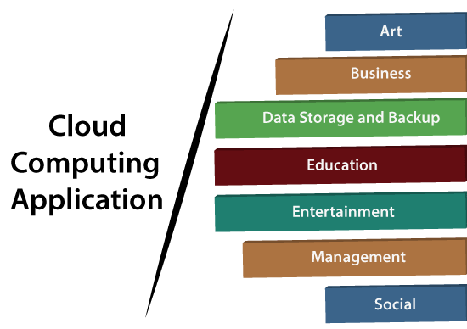
Application of Cloud Computing
Cloud computing is used in storage, education, healthcare, business, entertainment, web hosting, and AI/ML applications.
Data Storage & Backup – Store and backup files online.
Email Services – Gmail, Outlook, etc.
Entertainment – Netflix, YouTube, Spotify.
Healthcare – Store patient data and medical records.
Education – Online classes, learning platforms, and research.
Business – Business applications, collaboration, and data management.
AI & Machine Learning – Train and run AI models using cloud computing power.
Web Hosting – Host websites and web applications.
Mobile Applications – Store app data and provide online services.

Slide 8
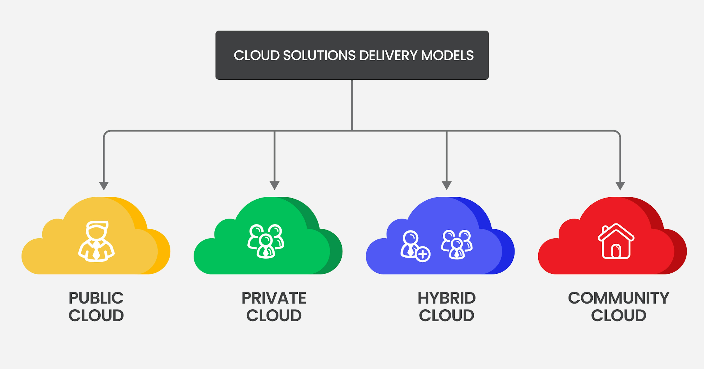
Cloud Computing Types
Private: One organization
Example: A bank uses its own private cloud to store customer information.
Public: Many users
Example: Google Cloud, Microsoft Azure, AWS — services are available to many customers over the Internet.
Hybrid: Private + Public
Example: A hospital keeps patient records in a private cloud but uses a public cloud for its website.
Community: Group with common needs
Example: Several universities share a cloud platform for research and academic resources.

Slide 9
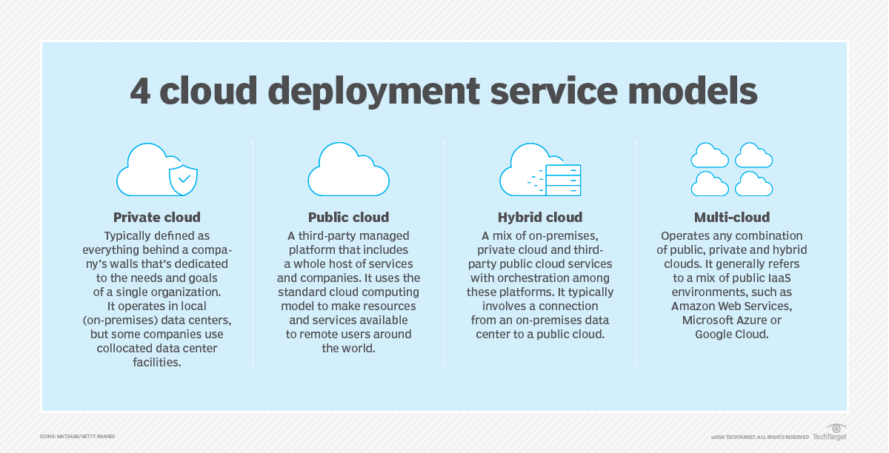
Cloud Computing Types(Conti..)
Public Cloud - the infrastructure is made available to the general public or a large industry group and is owned by the organization selling cloud services.
Private Cloud – the infrastructure is operated solely for an organization.
Hybrid Cloud – a composition of two or more Clouds (public, private, or community) as unique entities but bound by a standardized technology that enables data and application portability.
Community/Federated Cloud - the infrastructure is shared by several organizations and supports a community that has shared concerns.

Slide 10
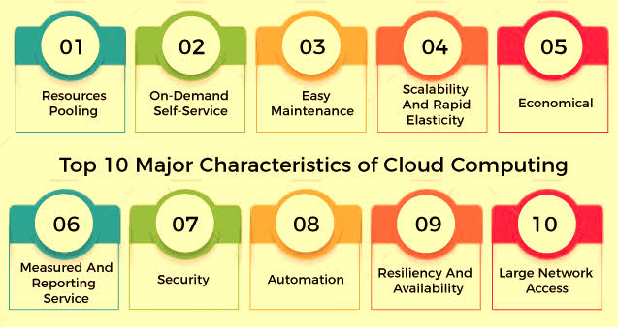
Characteristics Computing Services
Resource Pooling: Resources are shared among multiple users.
On-Demand Self-Service: Users can get resources whenever they need them.
Easy Maintenance: Cloud systems are regularly updated and maintained.
Scalability & Elasticity: Resources can quickly increase or decrease according to demand.
Cost-Effective: Pay only for the resources you use.
Measured Service: Usage is monitored for billing and resource management.
Security: Data is protected through backups and security mechanisms.
Automation: Tasks such as setup, configuration, and maintenance can be automated.

Slide 11
Cloud Computing Advantages
Resources, such as CPU cycles, storage, and network bandwidth, are shared.
When multiple applications share a system, their peak demands for resources are not synchronized thus, multiplexing leads to higher resource utilization.
Resources can be aggregated to support data-intensive applications.
Data sharing facilitates collaborative activities. Many applications require multiple types of analysis of shared data sets and multiple decisions carried out by groups scattered around the globe.
Notes:
Up to here talked a lot …

Slide 12
Cloud Computing Advantages
Eliminates the initial investment costs for a private computing infrastructure and the maintenance and operation costs.
Cost reduction: concentration of resources creates the opportunity to pay as you go for computing.
Elasticity: the ability to accommodate workloads with very large peak-to-average ratios.
User convenience: virtualization allows users to operate in familiar environments rather than in idiosyncratic ones.

Slide 13
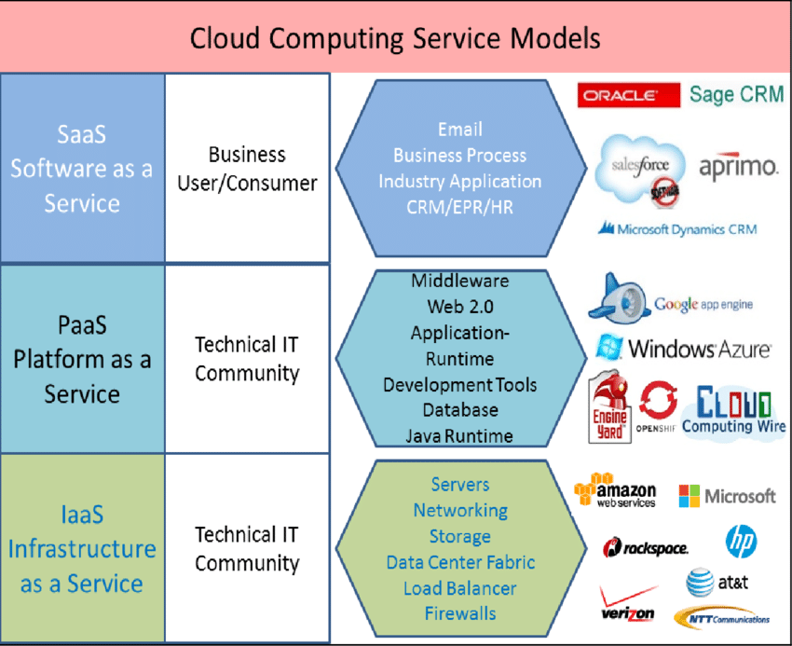
Cloud Computing Services

Slide 14
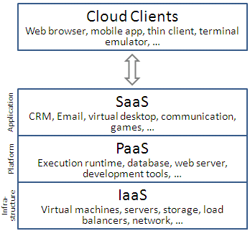
Cloud Delivery Models
Software as a Service (SaaS) (high level)
Platform as a Service (PaaS)
Infrastructure as a Service (IaaS) (low level)

Slide 15
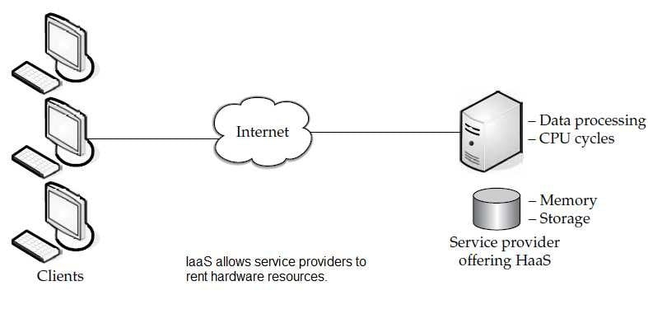
Infrastructure-as-a-Service (IaaS)
Definition: Amazon EC2
IaaS provides virtualized computing infrastructure such as servers, storage, and networking over the Internet, allowing users to run their own operating systems and applications.
Provides: Computing resources like CPU, virtual machines, storage, and networks.
User controls: Operating system, storage, and applications.
Provider manages: Physical servers and basic cloud infrastructure.
Services: Servers, storage, VMs, networking, load balancing, and bandwidth.

Slide 16
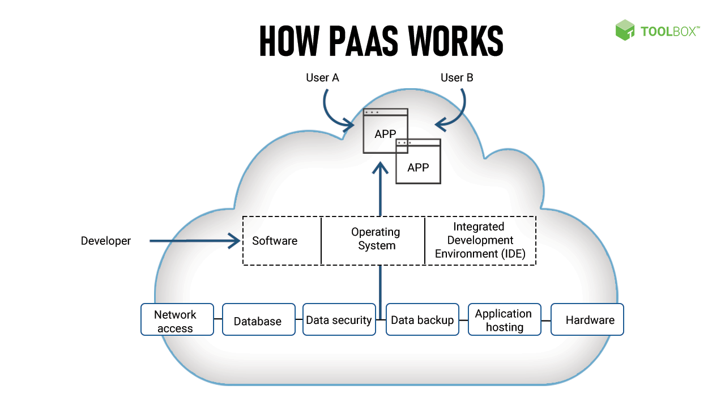
Platform-as-a-Service (PaaS)
Allows a cloud user to deploy consumer-created or acquired applications using programming languages and tools supported by the service provider.
The user:
  Has control over the deployed applications and, possibly, application hosting environment configurations.
  Does not manage or control the underlying Cloud infrastructure including network, servers, operating systems, or storage.
Not particularly useful when:
The application must be portable.
Proprietary programming languages are used.
The hardware and software must be customized
to improve the performance of the application.
Examples: Google App Engine, Windows Azure

Slide 17
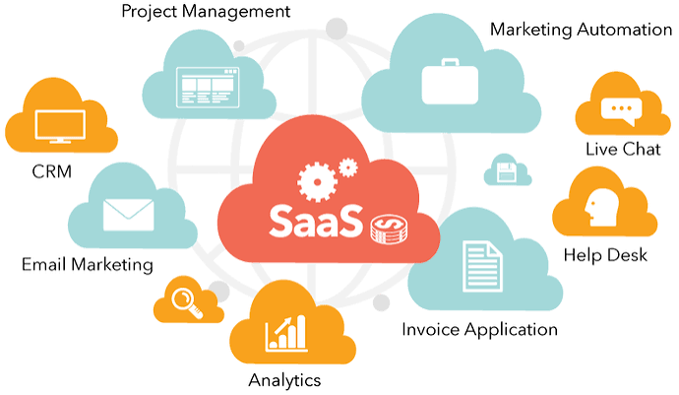
Software-as-a-Service (SaaS)
Applications are supplied by the service provider.
The user does not manage or control the underlying Cloud infrastructure or individual application capabilities.
Services offered include:
  Enterprise services such as: workflow management, communications, digital signature, customer relationship management (CRM), desktop software, financial management, geo-spatial, and search.
Not suitable for real-time applications or for those where data is not allowed to be hosted externally.
Examples: Gmail, Salesforce

Slide 18
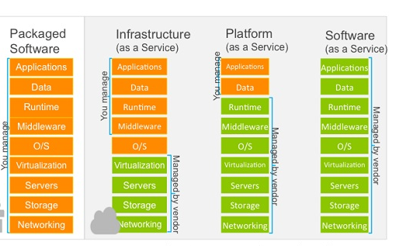
Three delivery models of Cloud Computing

Slide 19
Cloud activities
Service management and provisioning including:
  Virtualization.
  Service provisioning.
  Call center.
  Operations management.
  Systems management.
  QoS management.
  Billing and accounting, asset management.
  SLA management.
  Technical support and backups.

Slide 20
Cloud activities (cont’d)
Customer services such as:
    Customer assistance and on-line help.
    Subscriptions.
    Business intelligence.
    Reporting.
    Customer preferences.
    Personalization.
Integration services including:
    Data management.
    Development.

Slide 21
Cloud activities (cont’d)
Security management including:
  ID and authentication.
  Certification and accreditation.
  Intrusion prevention.
  Intrusion detection.
  Virus protection.
  Cryptography.
  Physical security, incident response.
  Access control, audit and trails, and firewalls.

Slide 22
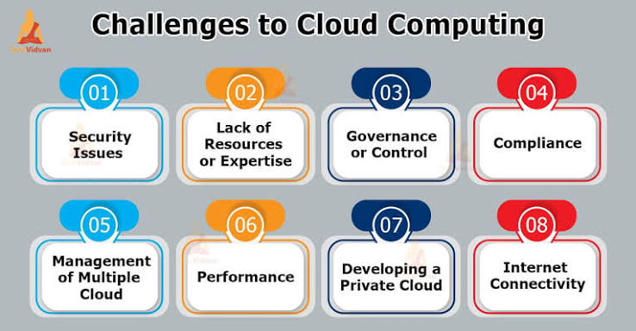
Challenges for cloud computing
Availability of service: what happens when the service provider cannot deliver?
Data confidentiality and auditability, a serious problem.
Diversity of services, data organization, user interfaces available at different service providers limit user mobility; once a customer is hooked to one provider it is hard to move to another.
Data transfer bottleneck; many applications are data-intensive.

Slide 23
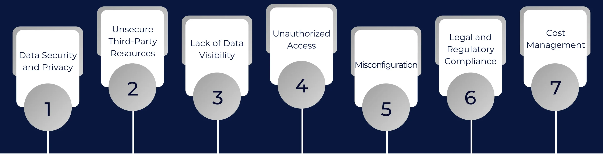
More challenges
Performance unpredictability, one of the consequences of resource sharing.
  How to use resource virtualization and performance isolation for QoS guarantees?
  How to support elasticity, the ability to scale up and down quickly?
Resource management: It is a big challenge to manage different workloads running on large data centers. Are self-organization and self-management the solution?
Security and confidentiality: major concern for sensitive applications, e.g., healthcare applications.
Addressing these challenges is on-going work!

Slide 24
Ethical issues
Paradigm shift with implications on computing ethics:
    The control is relinquished to third party services.
    Data is stored on multiple sites administered by several organizations.
    Multiple services interoperate across the network.
Implications:
    Unauthorized access.
    Data corruption.
    Infrastructure failure, and service unavailability.

Slide 25
De-perimeterisation
De-perimeterisation means removing the traditional boundary around an organization’s IT network.
It means users and data can access cloud services from anywhere, rather than being protected only by an organization’s internal network.
Example:
An employee works from home and securely accesses company files stored in the cloud.
Notes:
In information security, de-perimeterisation^{[1]} is the removal of a boundary between an organisation and the outside world. De-perimeterisation is protecting an organization's systems and data on multiple levels by using a mixture of encryption, secure computer protocols, secure computer systems and data-level authentication, rather than the reliance of an organization on its network boundary to the Internet. Successful implementation of a de-perimeterised strategy within an organization implies that the perimeter, or outer security boundary, was removed.

Slide 26
Privacy issues
Cloud service providers have already collected petabytes of sensitive personal information stored in data centers around the world. The acceptance of Cloud Computing therefore will be determined by privacy issues addressed by these companies and the countries where the data centers are located.
Privacy is affected by cultural differences; some cultures favour privacy, others emphasize community. This leads to an ambivalent attitude towards privacy in the Internet which is a global system.

Slide 27
Cloud Vulnerabilities
Clouds are affected by malicious attacks and failures of the infrastructure, e.g., power failures.
Such events can affect the Internet domain name servers and prevent access to a Cloud or can directly affect the Clouds:
    in 2004 an attack at Akamai caused a domain name outage and a major blackout that affected Google, Yahoo, and other sites.
    in 2009, Google was the target of a denial-of-service attack which took down Google News and Gmail for several days;
    in 2012 lightning caused a prolonged down time at Amazon.

Slide 28
Back to Basics -- Parallel Computing
“Parallel computing is a form of computation in which many calculations are carried out simultaneously, operating on the principles that large problems can often be divided into smaller ones, which are then solved concurrently (in parallel).” Wikipedia
Hardware and software systems allow us to:
  Solve problems demanding resources not available on a single system.
  Reduce the time required to obtain a solution.

Slide 29
Parallel Computing – Amdahl’s Law
The speedup S measures the effectiveness of parallelization:
S(N) = T(1) / T(N)
  T(1) → the execution time of the sequential computation.
  T(N) → the execution time when N parallel computations are executed
Amdahl's Law: if α is the fraction of running time a sequential program spends on non-parallelisable segments of the computation then:
S ≅ 1/ α
This is a theoretical upper bound on the best speedup we can get from parallelising a certain program.

Slide 30
Back to Basics -- Distributed systems
Collection of autonomous computers, connected through a network and distribution software (often) called middleware which enables computers to coordinate their activities and to share system resources for a common goal.
Characteristics:
  The users perceive the system as a single, integrated computing facility.
  The components are autonomous.
  Scheduling and other resource management and security policies are implemented by each system.
  There are multiple points of control and multiple points of failure.
  The resources may not be accessible at all times.
  Can be scaled by adding additional resources.
  Can be designed to maintain availability even at low levels of hardware/software/network reliability.

Slide 31
Summary
What is Cloud Computing?
Early models of Cloud Computing
Importance of Cloud Computing
Applications of Cloud Computing
Types of Cloud Computing
Advantages of Cloud Computing
Delivery models and services
Cloud activities
Ethical issues in Cloud Computing.
Cloud vulnerabilities.
Parallel Computing.
Challenges
Distributed Systems
Assignment

